Slide 1
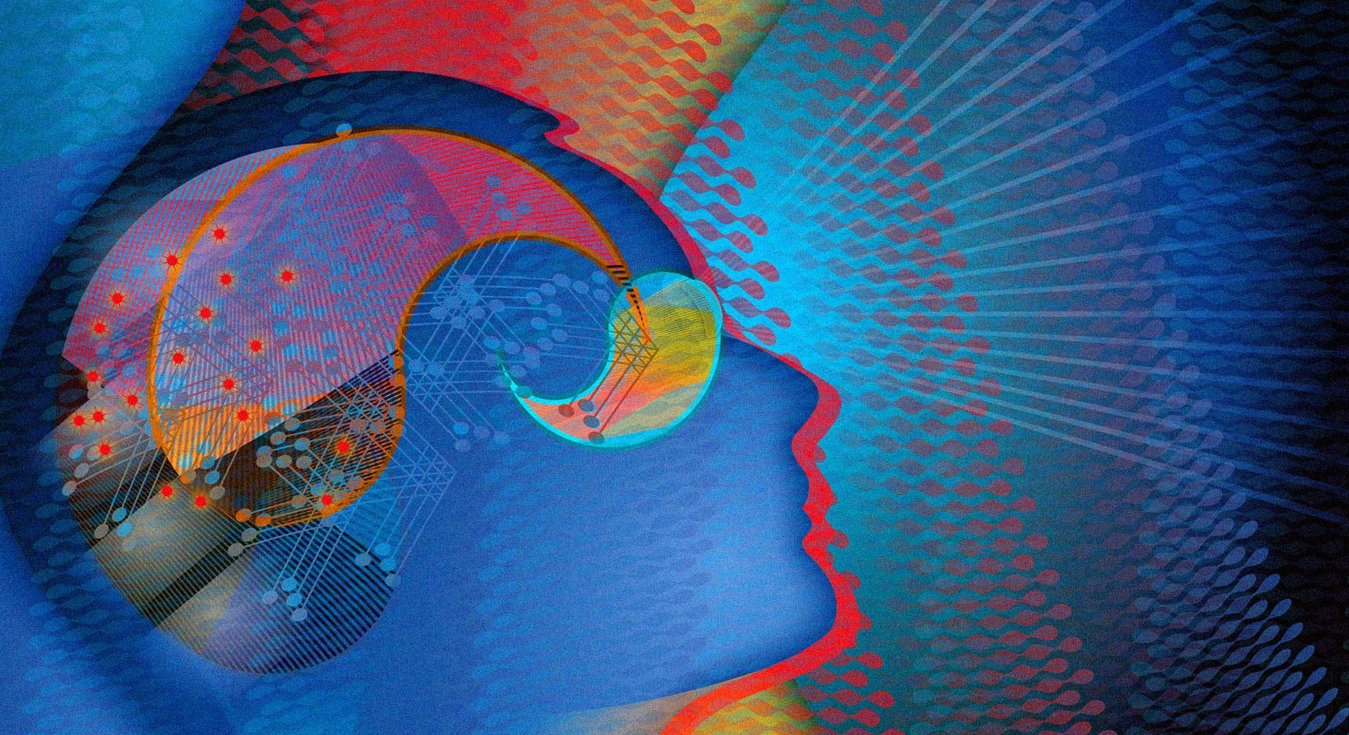
Introduction to Deep Learning (Computer vision)
Aaron Y. Lee MD MSCI
University of Washington

Slide 2
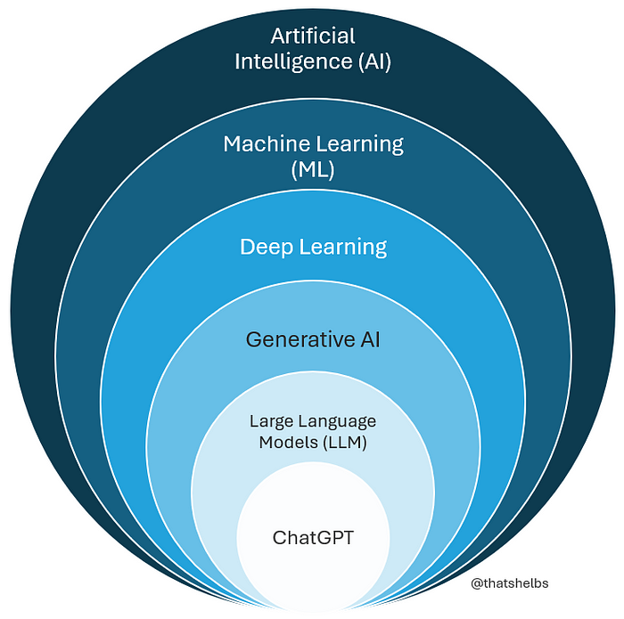

Slide 3
Computer vision: Giving machines the ability to “see.”

Slide 4
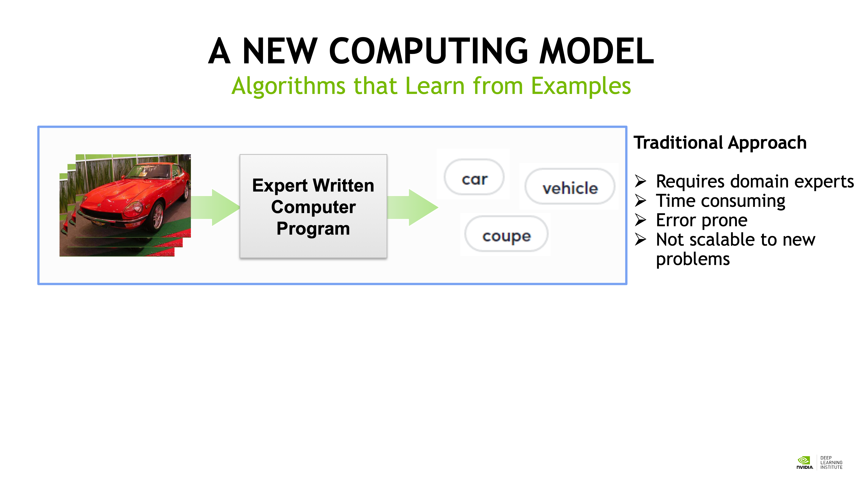

Slide 5
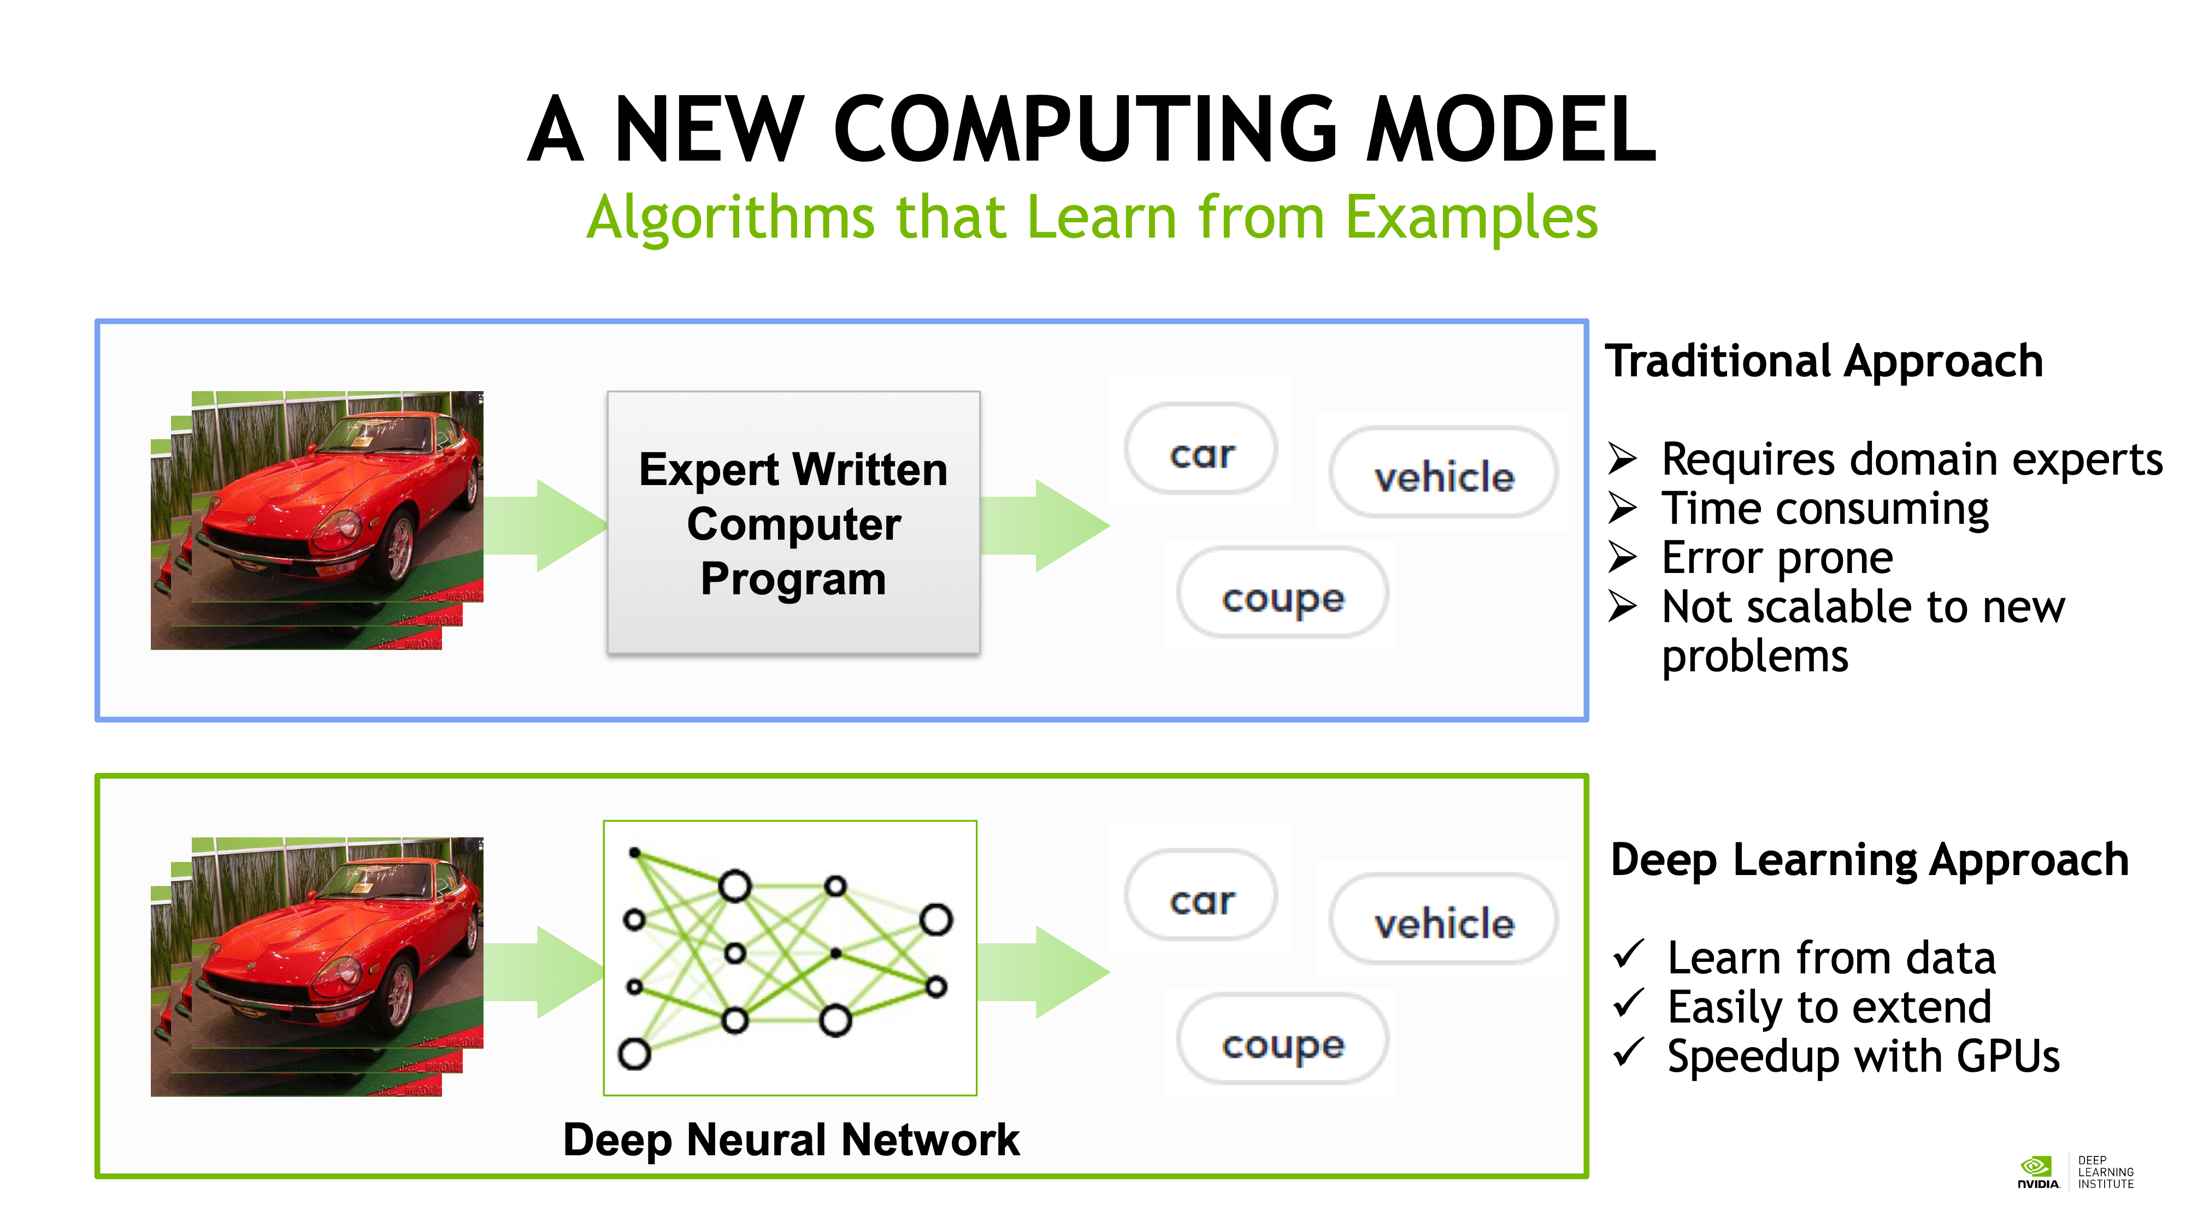

Slide 6
Lifecycle of a computer vision DL project
Define your problem (model)
Collect, clean, collate, partition data (input)
Torture humans to label the data (output)
Train model (hyperparameters)
Repeat 4, sometimes 2-4 (model parameters/weights)
Test the model a final time (test set performance)
Write a paper, publish a github repo (data + model + weights or at least model + weights)

Slide 7
Lifecycle of a computer vision DL project
Define your problem (model)
Collect, clean, collate, partition data (input)
Torture humans to label the data (output)
Train model (hyperparameters)
Repeat 4, sometimes 2-4 (model parameters/weights)
Test the model a final time (test set performance)
Write a paper, publish a github repo (data + model + weights or at least model + weights)

Slide 8
Supervised Learning
(We know the right answer)

Slide 9

No Diabetic Retinopathy
Mild NPDR
Moderate NPDR
Severe NPDR
PDR
Given an image, output one of these 5 severities.
Classification

Slide 10
Given an image, output the ETDRS severity level (0-100).
Regression

Slide 11
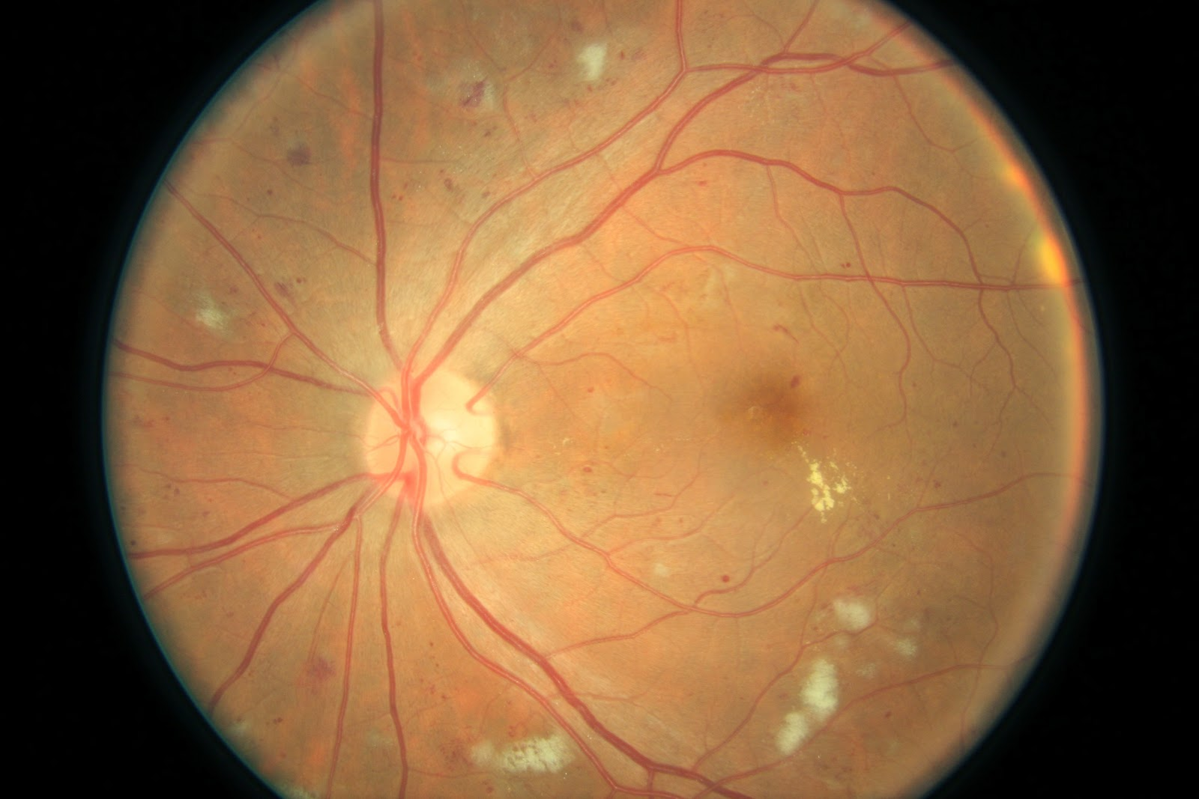
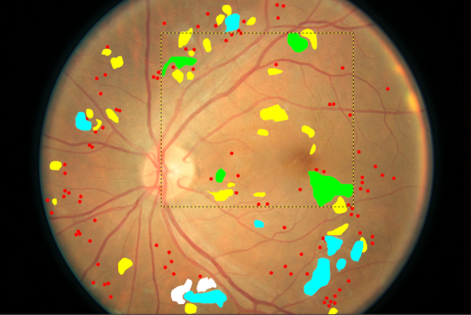
Given an image, output the locations of MA, HEx, CWS, and NV.
Feature Segmentation

Slide 12
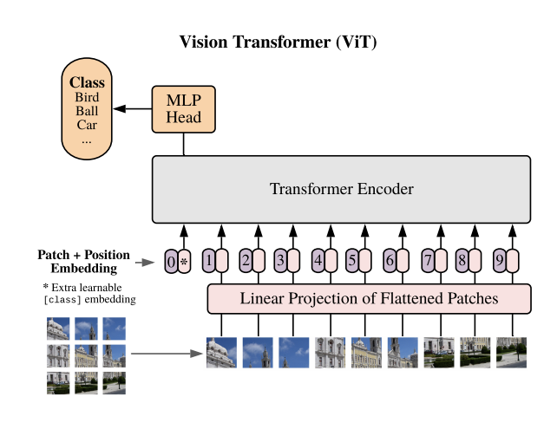
Model choices (Classification)
Convolutional Models
VGG series
Resnet series
EfficientNet series
Vision Transformer Models
Vit series
Initialization:
Random weights
Imagenet pretrained weights
Foundation model weights

Slide 13
Lifecycle of a computer vision DL project
Define your problem (model)
Collect, clean, collate, partition data (input)
Torture humans to label the data (output)
Train model (hyperparameters)
Repeat 4, sometimes 2-4 (model parameters/weights)
Test the model a final time (test set performance)
Write a paper, publish a github repo (data + model + weights or at least model + weights)

Slide 14
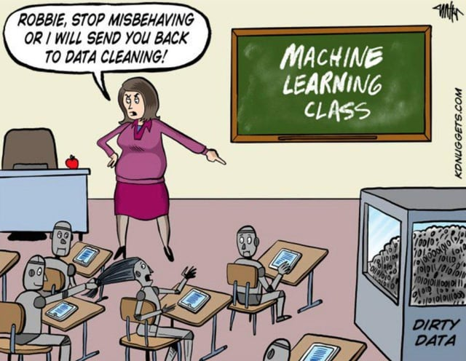
Data Cleaning = 99% of the work

Slide 15
Preparing AI-Ready Data
OMOP
Demographics
Survey data
Physical assessment data
Medications
Blood and urine lab values
MOCA
Vision testing
DICOM
Fundus photography
OCT
OCTA
FLIO
Waveform Database (WFDB)
ECG
mHealth
Physical activity monitor
Continuous glucose monitor
Earth Science Data Specification
Environmental sensor

Slide 16
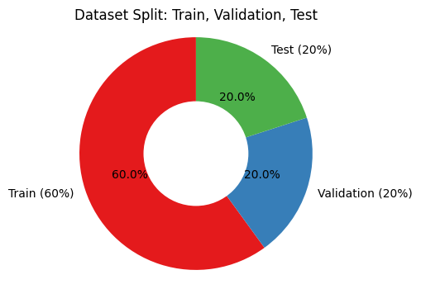
Partitioning data
Training Data (60%)
Used to adjust the model to learn from the data
Validation Data (20%)
Used to periodically check how well the model is doing.
Model weights are NOT adjusted
Used during training session and for hyperparameter tuning.
Test Data (20%)
Used to evaluate the final performance of the final model (ideally once at the end)
Model weights are NOT adjusted
Unit of partition: person

Slide 17
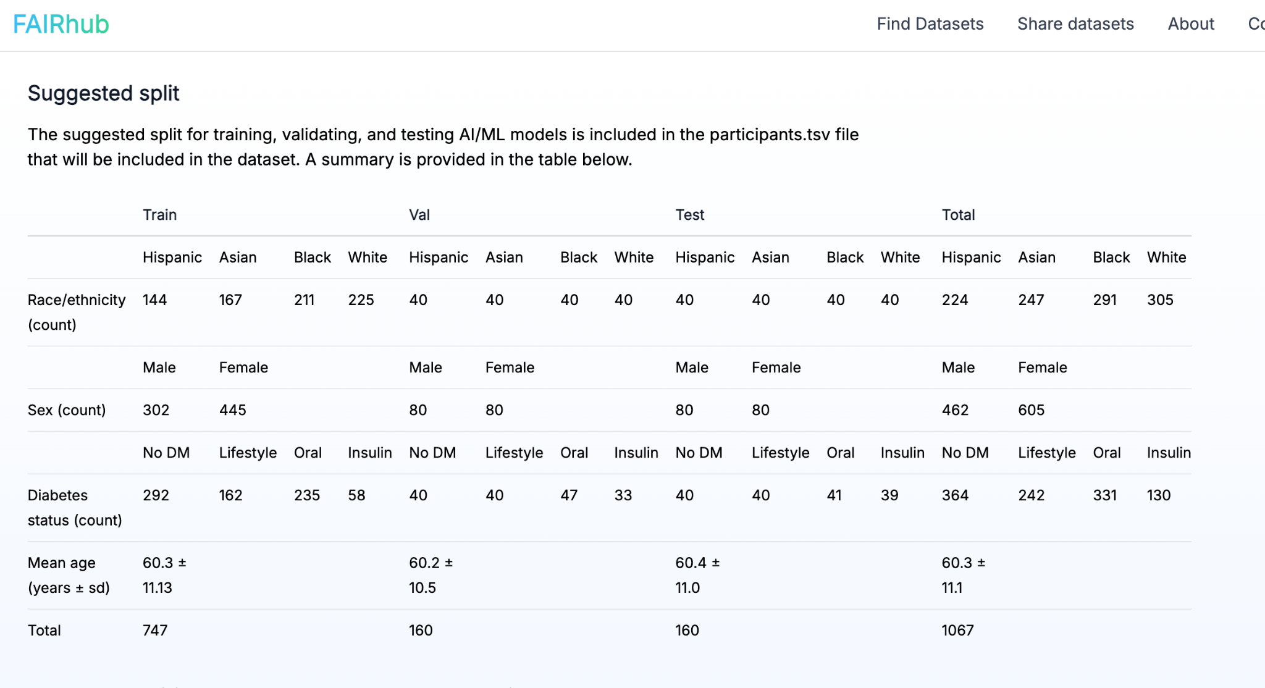

Slide 18
Lifecycle of a computer vision DL project
Define your problem (model)
Collect, clean, collate, partition data (input)
Torture humans to label the data (output)
Train model (hyperparameters)
Repeat 4, sometimes 2-4 (model parameters/weights)
Test the model a final time (test set performance)
Write a paper, publish a github repo (data + model + weights or at least model + weights)

Slide 19
Tradeoffs
Ideal setup:
2 expert graders all grade the same images
A third arbiter (even more of an expert), masked to the identities of the graders, regrades and provides a final grade
Con: very labor intensive
Most common setup:
Have n graders each grade on their own
Not everyone is the same level of expertise
Not everyone grades the same number of images
Con: model performance will likely be a mixed bag.

Slide 20
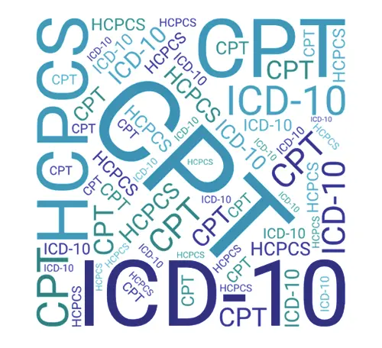
Leverage existing labels
Derive labels from diagnosis codes, CPT codes, etc. from EHR
Noisy and can be unreliable
CPT procedure codes are better labels as they are true “events”
Derive labels from lab tests, future events (eg readmission, need for surgery)
Can be acutely altered in extreme situations

Slide 21
Models will never do better than the average human error.

Slide 22
Moderate
Severe NPDR

Slide 23
Try to use objective ground truth for labels (not derived from humans).

Slide 24
Lifecycle of a computer vision DL project
Define your problem (model)
Collect, clean, collate, partition data (input)
Torture humans to label the data (output)
Train model (hyperparameters)
Repeat 4, sometimes 2-4 (model parameters/weights)
Test the model a final time (test set performance)
Write a paper, publish a github repo (data + model + weights or at least model + weights)

Slide 25
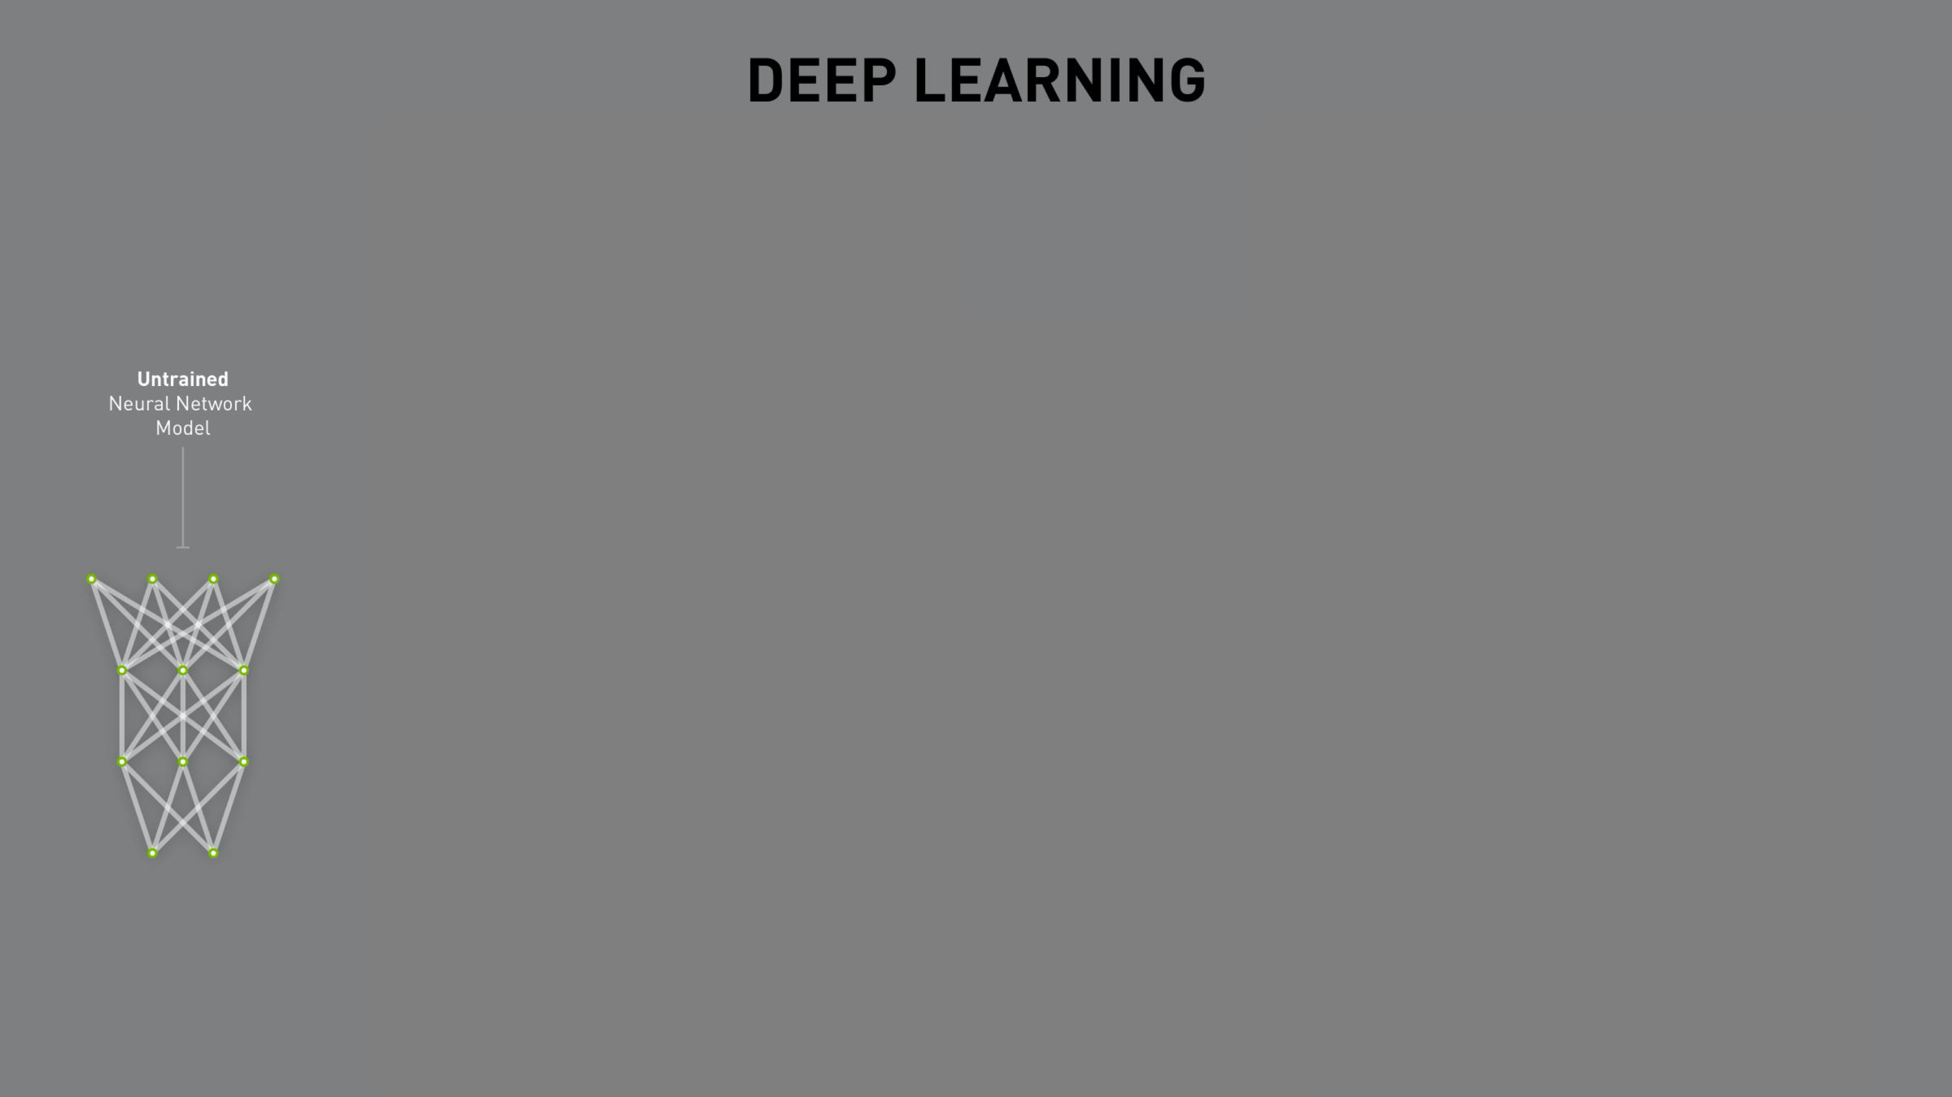

Slide 26
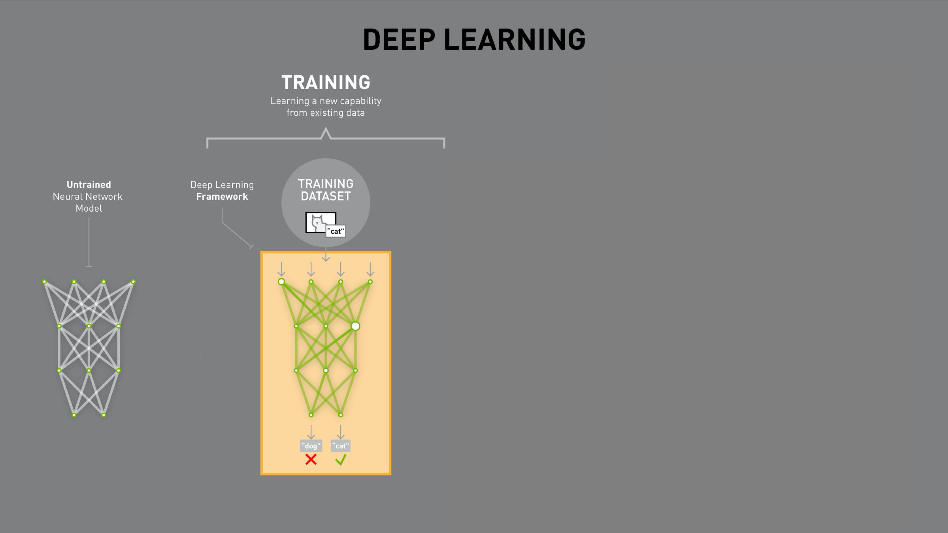

Slide 27


Slide 28





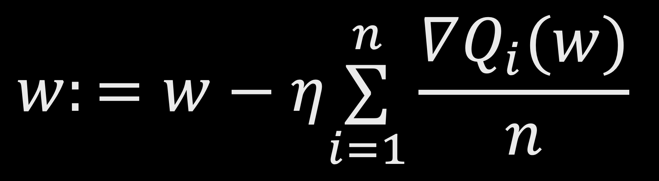
How does it actually learn?
Random initialization
Worse
Derivative
$$w:=w−η\overset{n}{\underset{i=1}{∑}}\frac{∇Q_{i}(w)}{n}$$
Performance
Random
initialization
Gradient
Learning
rate
Better
Objective evaluation function
Stochastic Gradient Descent

Slide 29
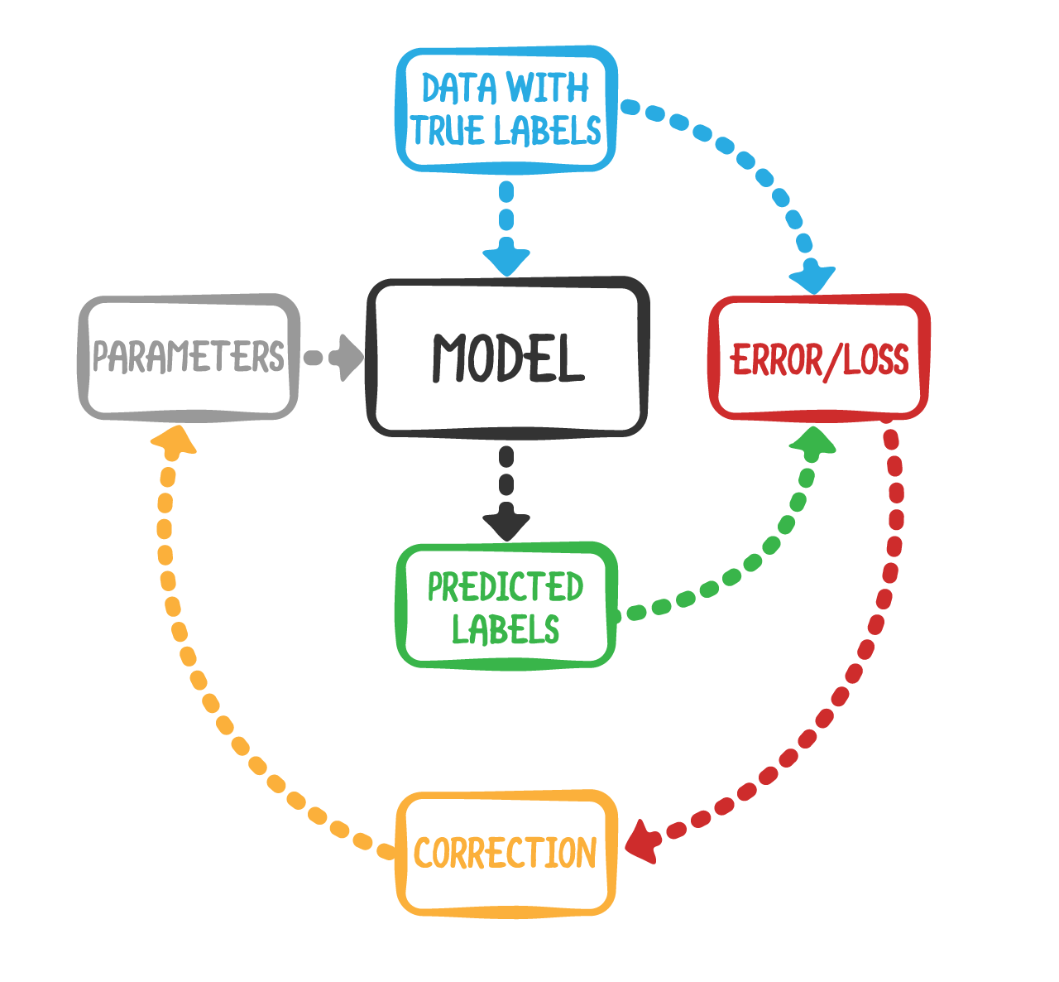
Training loop
Epoch 1:
Shuffle training data
Divide into small batches
For each batch: adjust the model slightly
After going through all the training data, freeze the model and test on validation dataset
Epoch 2:
Repeat
Epoch 3:
Repeat

Slide 30
Lifecycle of a computer vision DL project
Define your problem (model)
Collect, clean, collate, partition data (input)
Torture humans to label the data (output)
Train model (hyperparameters)
Repeat 4, sometimes 2-4 (model parameters/weights)
Test the model a final time (test set performance)
Write a paper, publish a github repo (data + model + weights or at least model + weights)

Slide 31
What are hyperparameters?
Parameters = how the model will behave for a given input.
Hyperparameters = things we can adjust that will ultimately lead to better parameters
Examples: batch size, learning rate, optimizer, number of epochs
They affect how a training session behaves but not how a deployed model behaves.

Slide 33
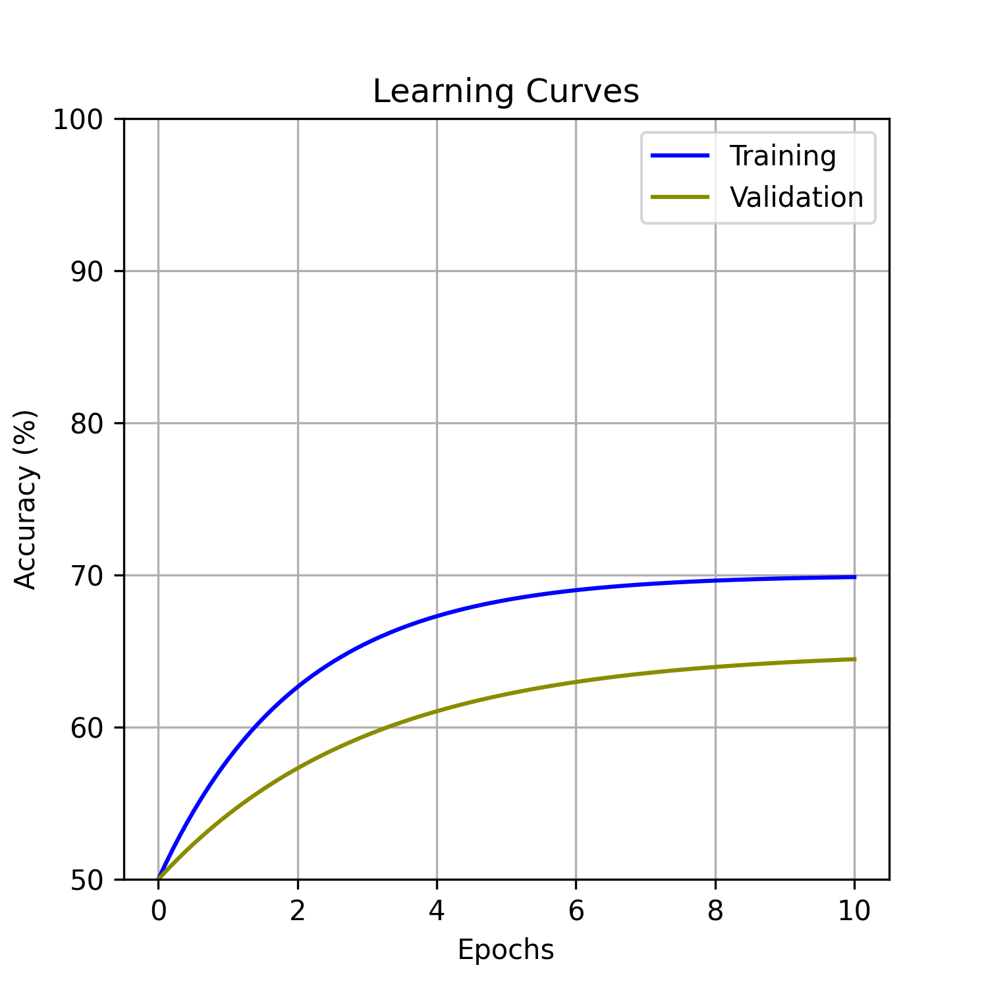
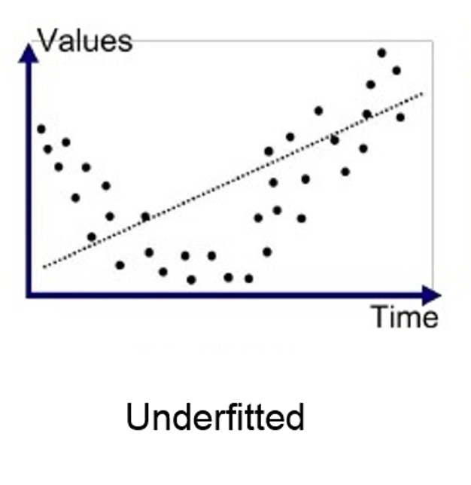
Increase model complexity

Slide 34
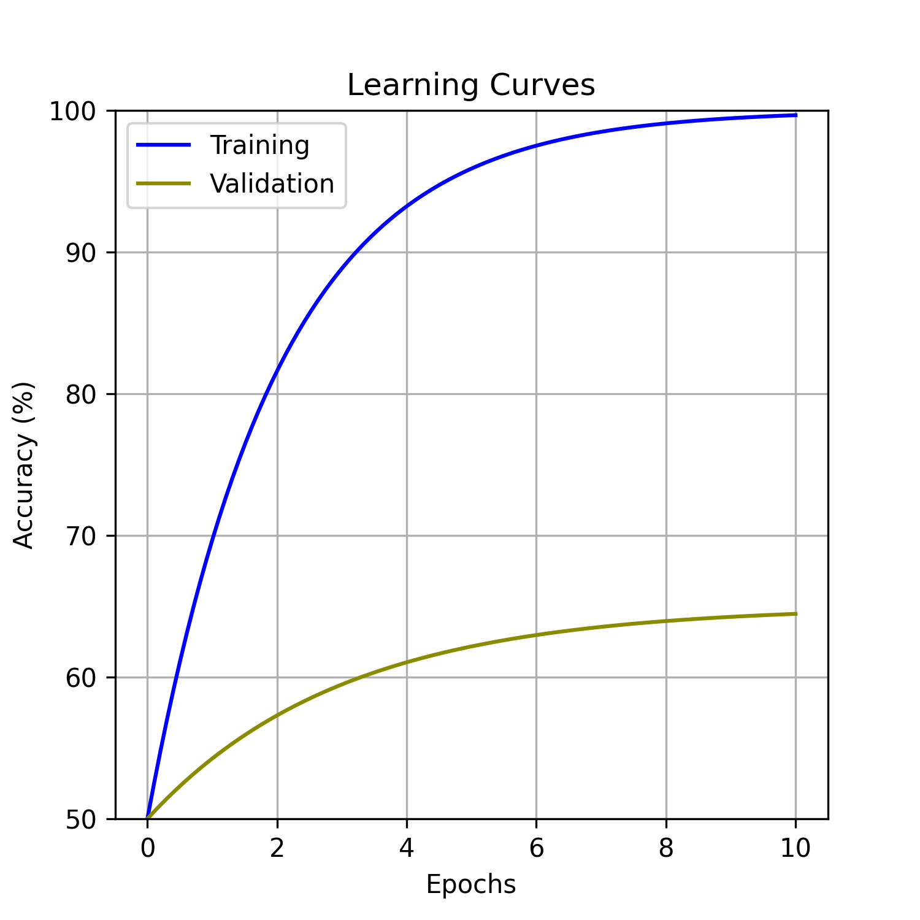
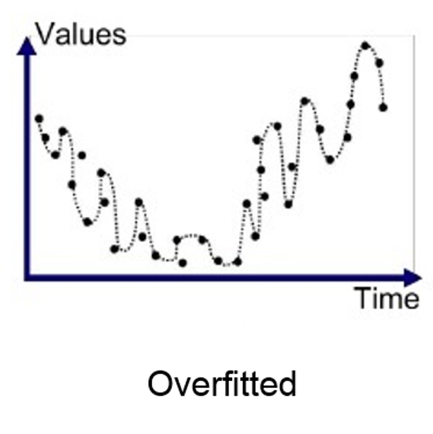
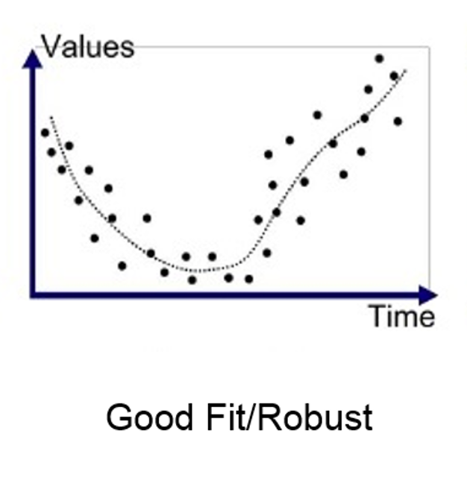
Get more data,
add regularization

Slide 35
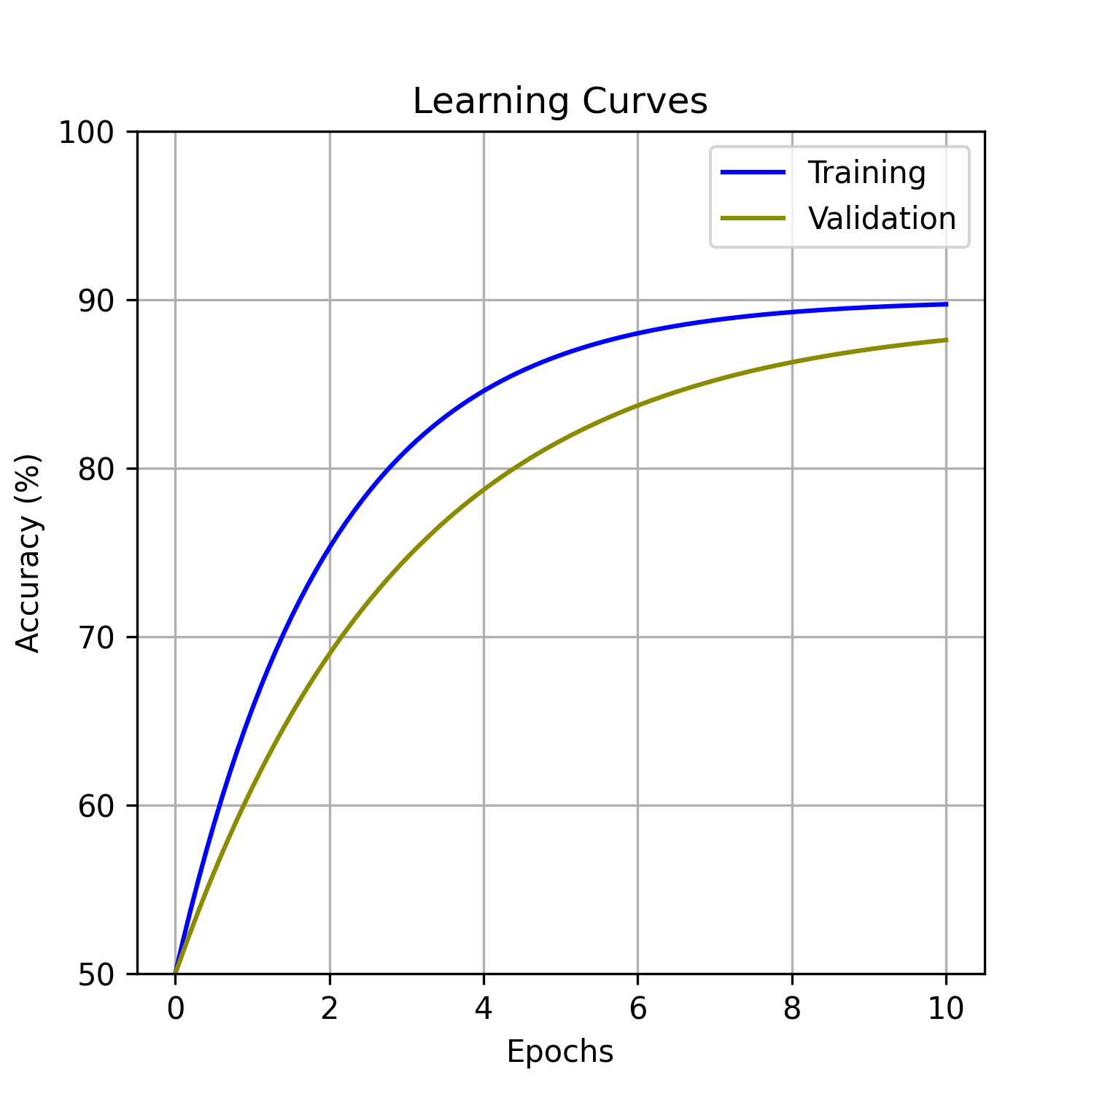
All done!

Slide 37
Tip: Take a small sample of your training set and try to overfit it.

Slide 38
Lifecycle of a computer vision DL project
Define your problem (model)
Collect, clean, collate, partition data (input)
Torture humans to label the data (output)
Train model (hyperparameters)
Repeat 4, sometimes 2-4 (model parameters/weights)
Test the model a final time (test set performance)
Write a paper, publish a github repo (data + model + weights or at least model + weights)

Slide 39
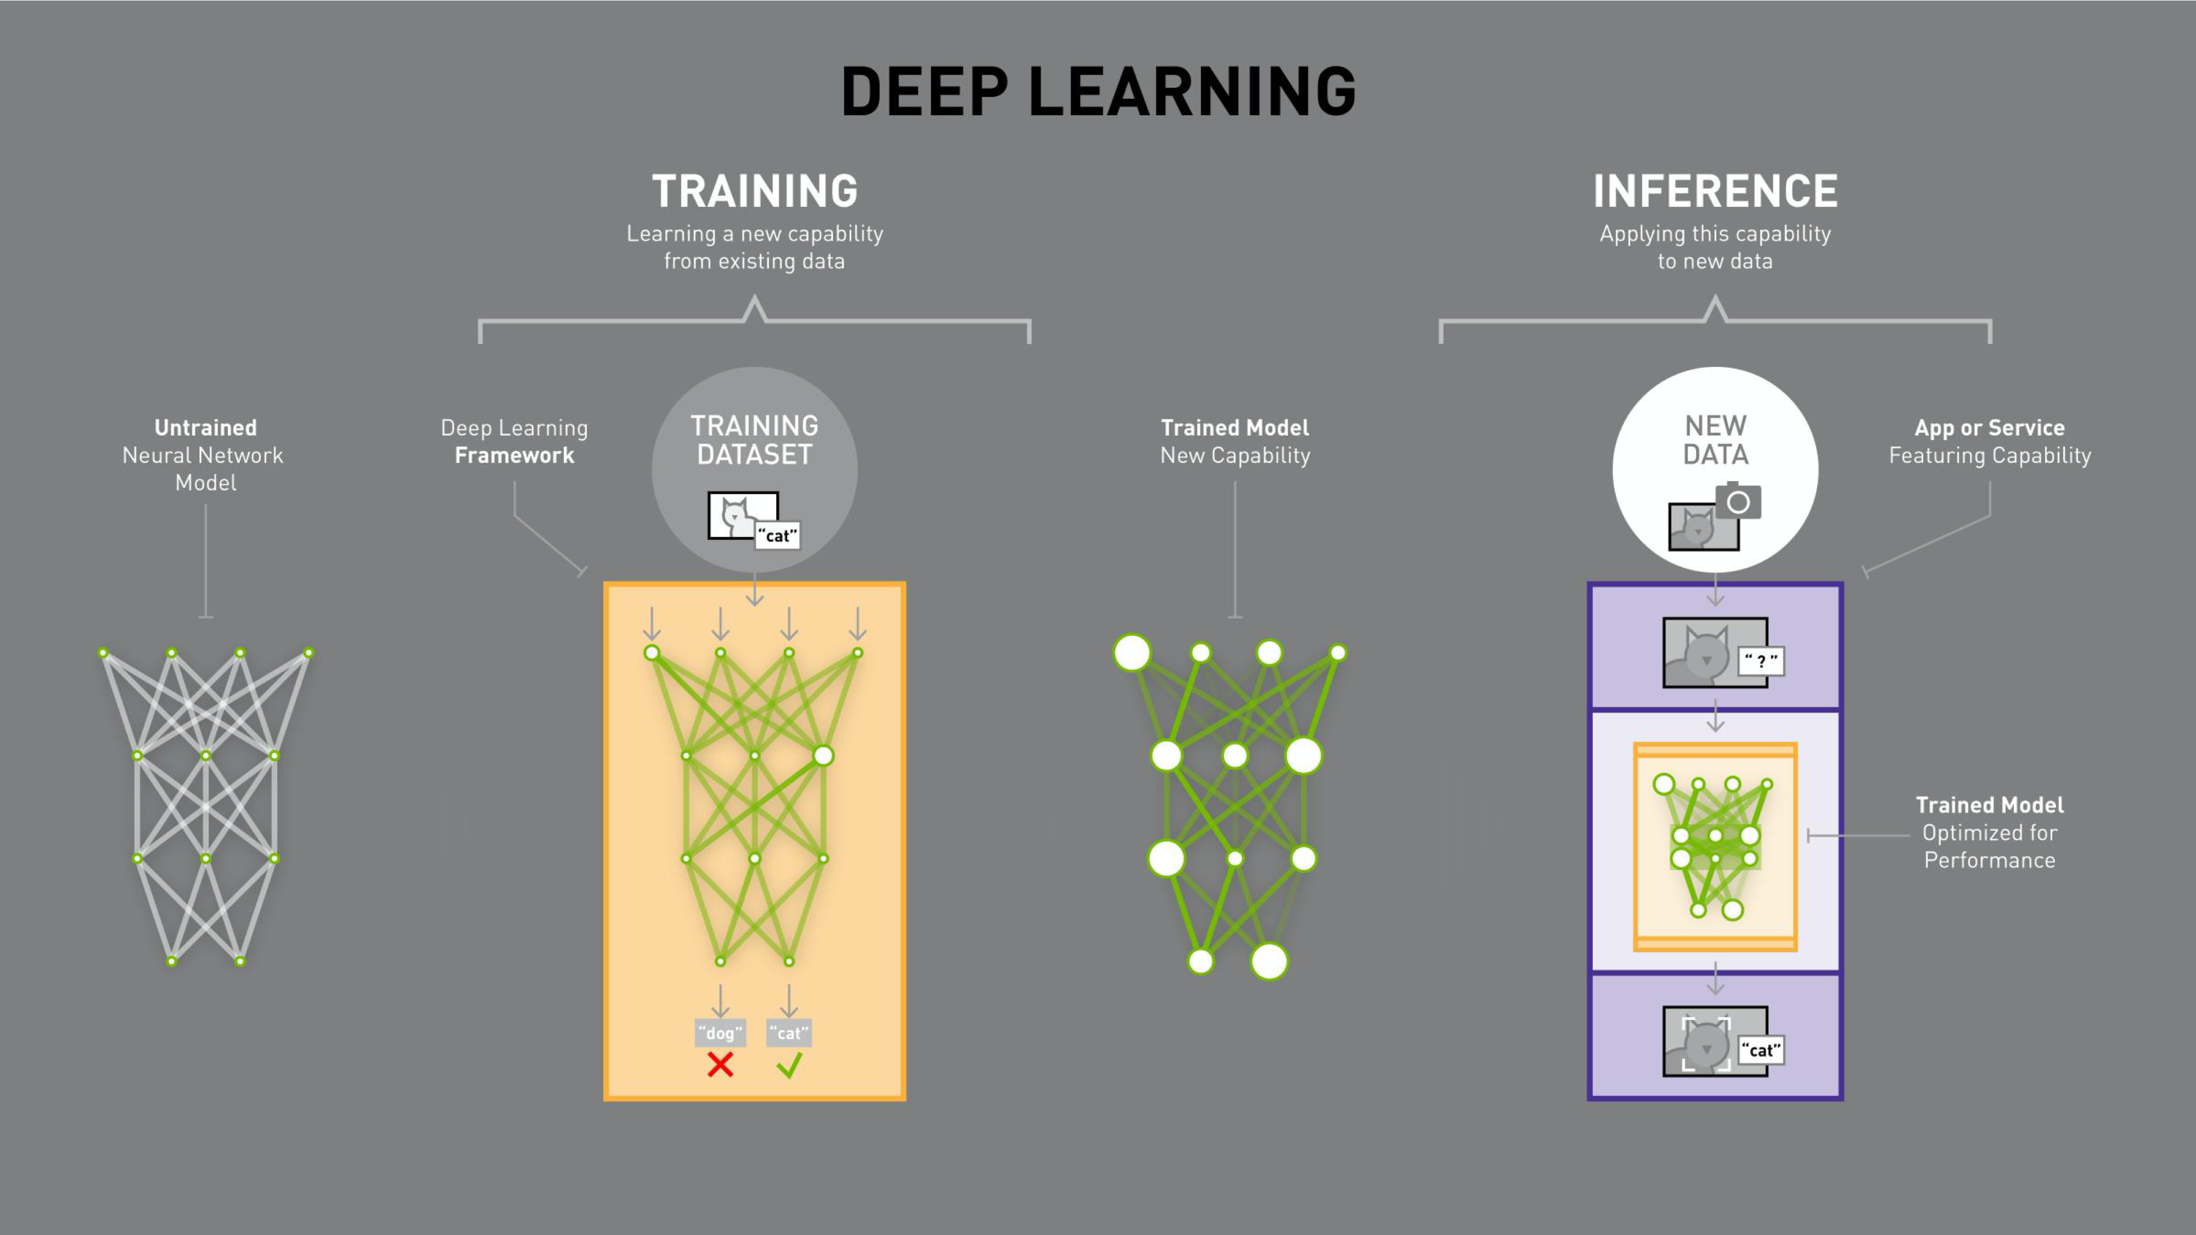

Slide 40
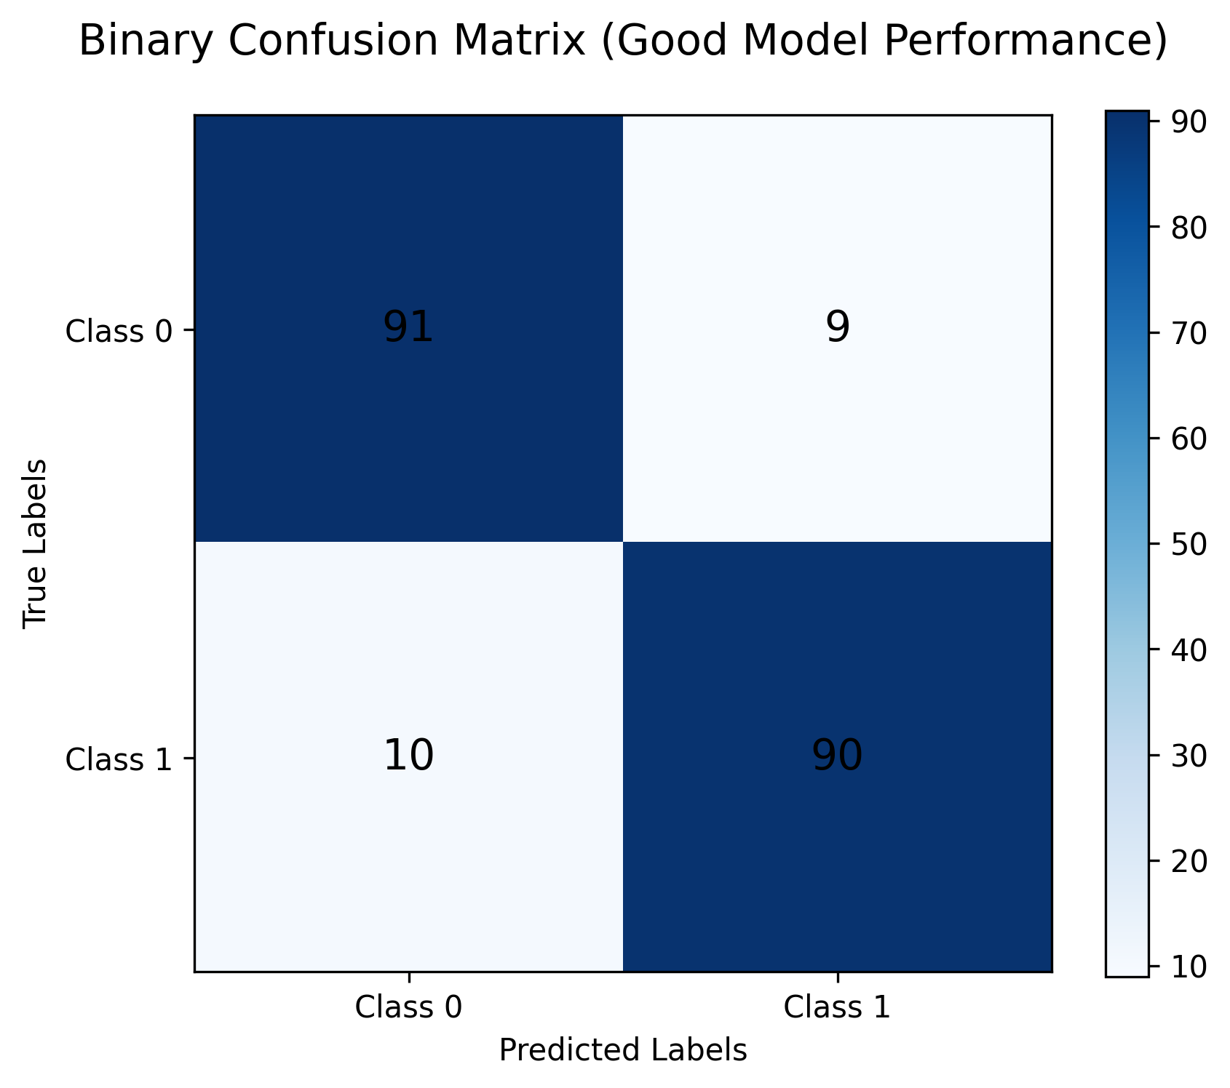
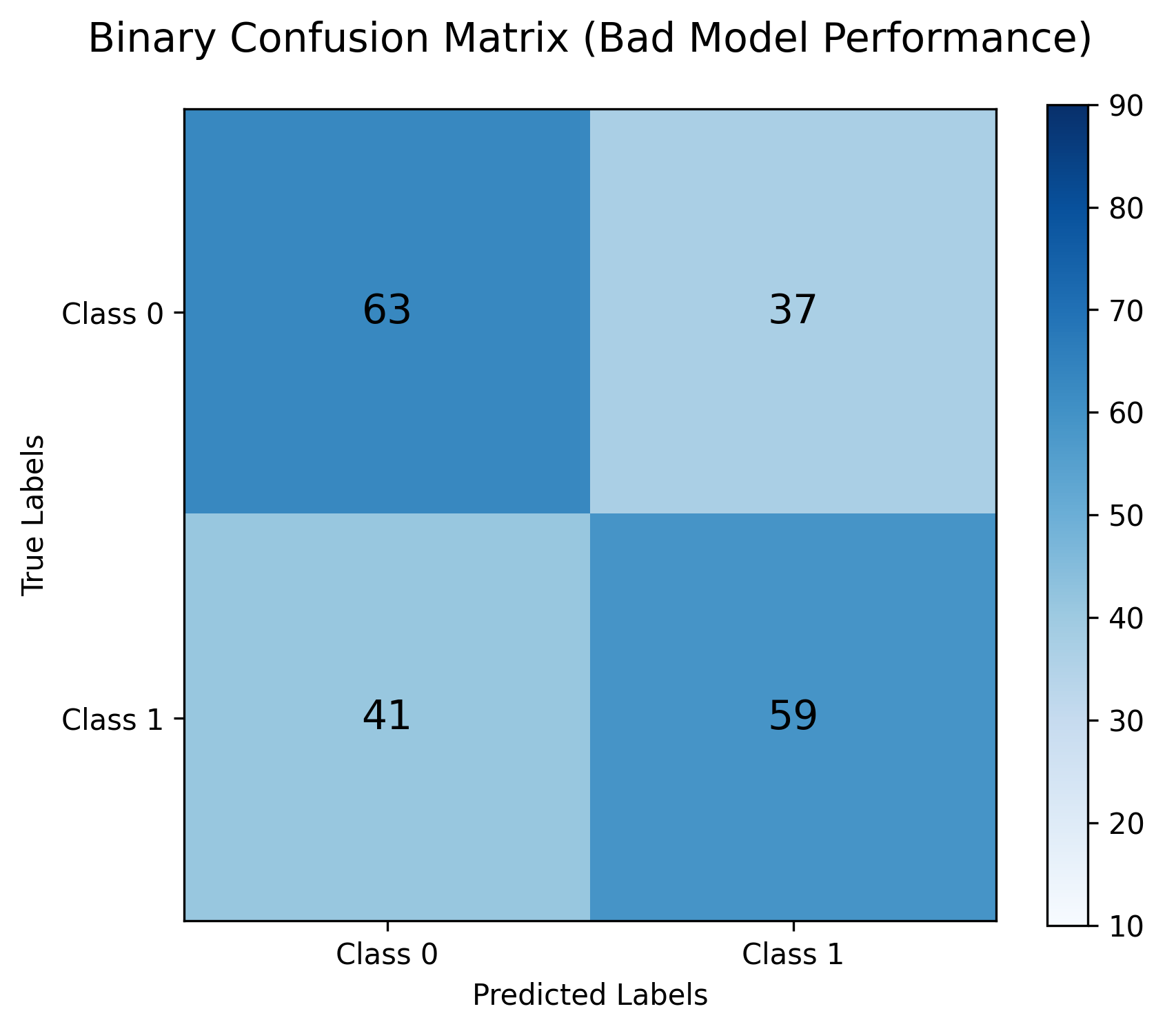
Confusion Matrix
(Basically a 2x2 contingency table for binary classification)

Slide 41
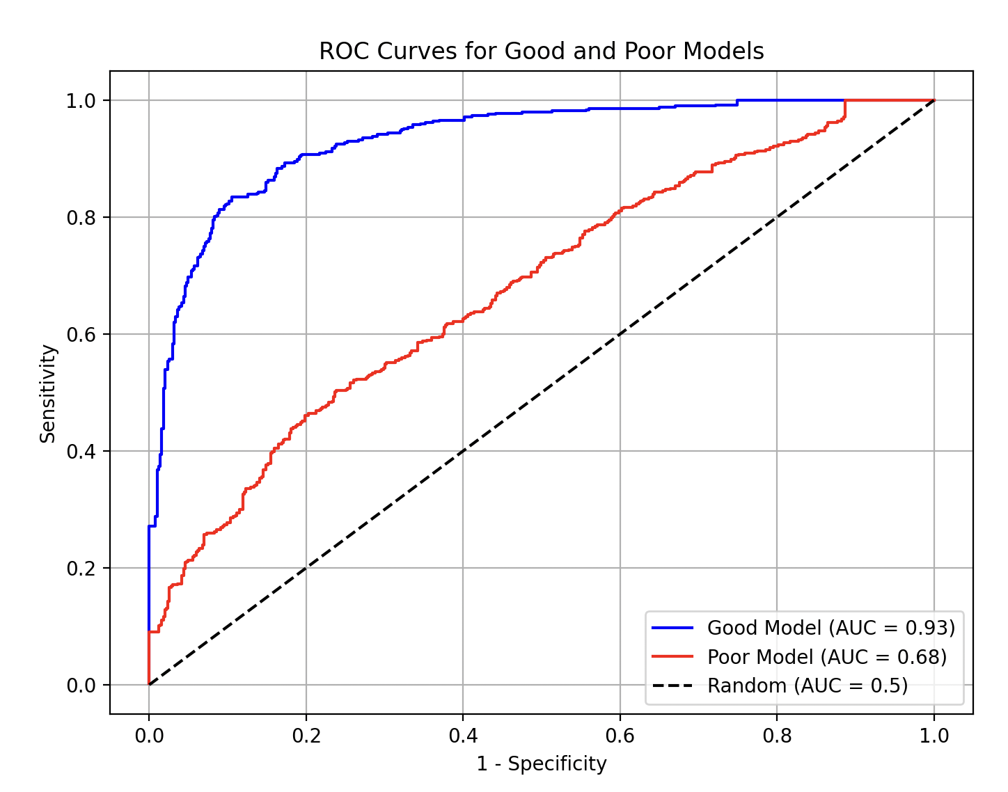
Receiver Operator Characteristic curve (for balanced datasets)
The model will produce an output between 0 and 1.
We can vary the threshold and recalculate the Sensitivity and Specificity for each threshold
Random behavior = diagonal line
Area under curve = AUROC

Slide 42
Lifecycle of a computer vision DL project
Define your problem (model)
Collect, clean, collate, partition data (input)
Torture humans to label the data (output)
Train model (hyperparameters)
Repeat 4, sometimes 2-4 (model parameters/weights)
Test the model a final time (test set performance)
Write a paper, publish a github repo (data + model + weights or at least model + weights)

Slide 43
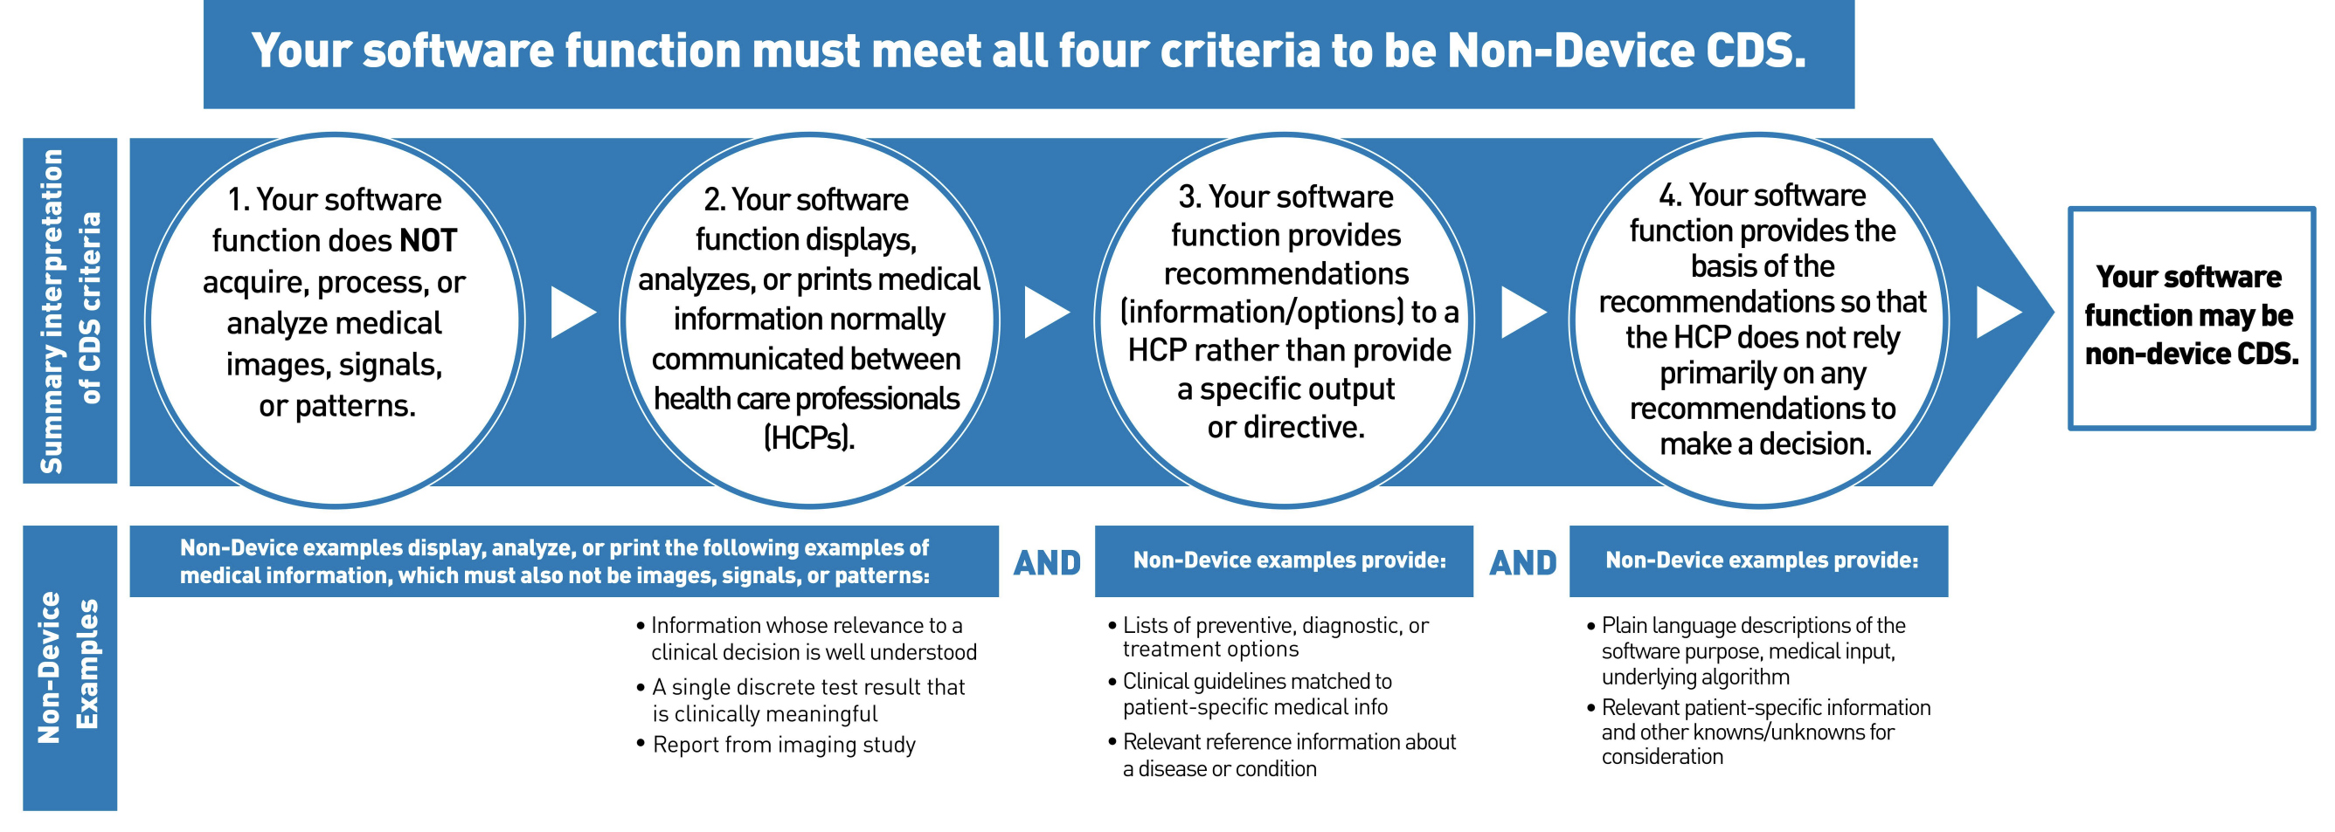
Do you need FDA approval before you can use this in clinical care?

Slide 44






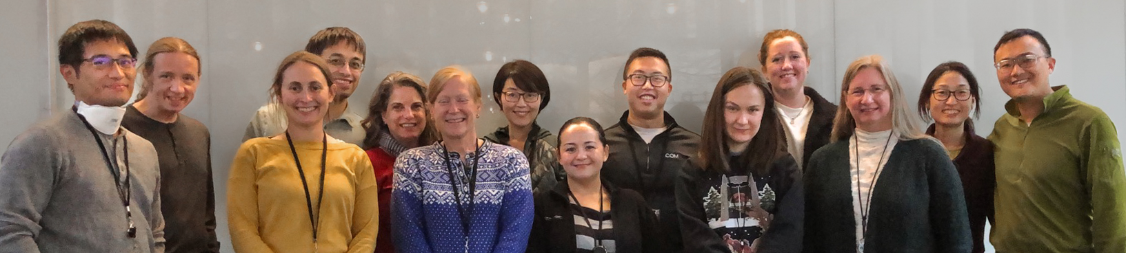
Acknowledgements
Funding Sources: NIH 1OT2OD032644, NIH/NIA R01 AG060942, NIH/NEI K23EY024921, NIA/NIH U19AG066567, Research to Prevent Blindness, Latham Vision Research Innovation Award, Latham Fund for Vision Research, Donors to Computational Ophthalmology Fund
Aaron Lee, MD MSCI
Cecilia Lee, MD MS
https://comp.ophthalmology.uw.edu
Megan Lacy MS
Julia Owen PhD
Yue Wu PhD
Scott Song BA
Missy Takahashi BS
Ashley Batchelor MS
Matthew Hunt BS
Theodore Spaide PhD
Marian Blazes MD
Jamie Shaffer MS
Yuka Kihara MS
Randy Lu BS
Emily Heindsmann MA
Christina Duong BS COA
Yelena Bagdasarova PhD

